Slide 1

BARRIERS OF COMMUNICATION ENGLISH LAB ACTIVITY
Jasdeep Singh
2421076
b. Tech (it)

Slide 2

WHAT IS COMMUNICATION BARRIER ?
Definition: Obstacles that interfere with the transmission, reception, and understanding of a message.
Importance: Understanding barriers is key to improving communication effectiveness.

Slide 3
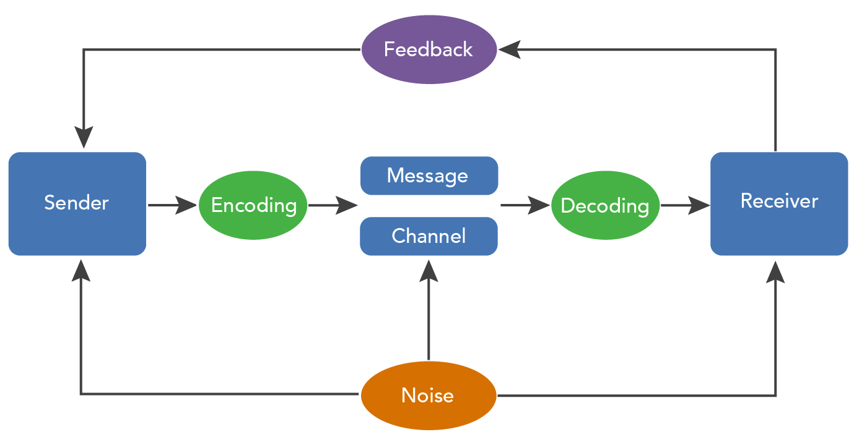

Slide 4

TYPES OF BARRIERS OF COMMUNICATION
Physical Barriers: Noise, distance, poor equipment.
Language Barriers: Vocabulary, jargon, accents.
Psychological Barriers: Stress, emotions, prejudice.
Cultural Barriers: Differing norms, values, traditions.

Slide 5
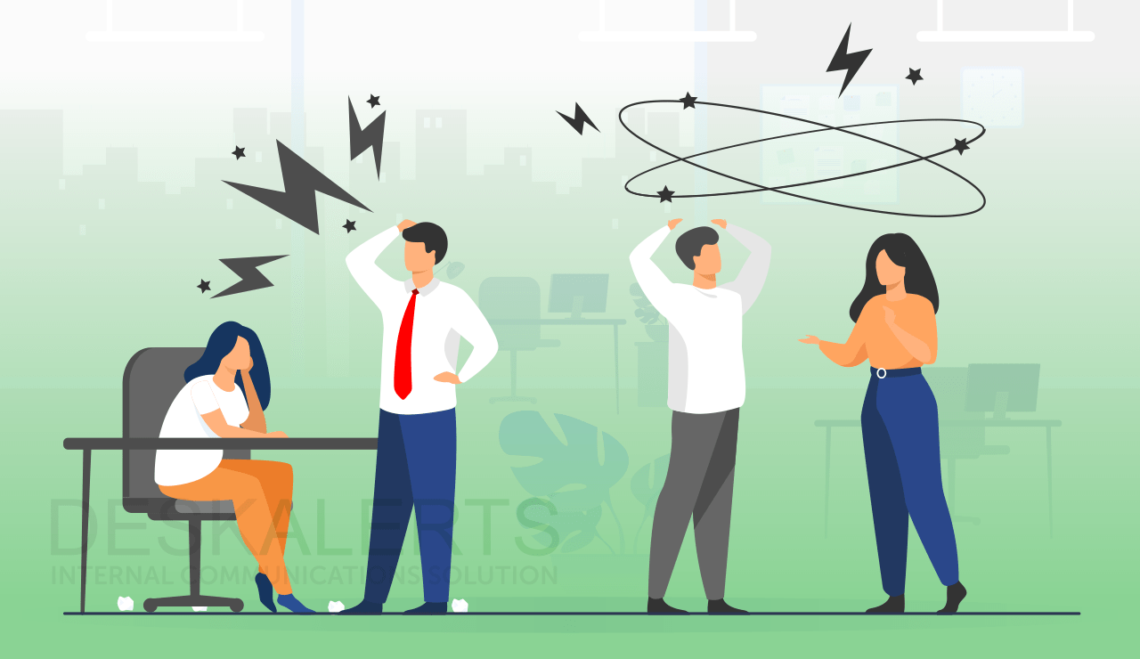
IMPACT OF BARRIERS COMMUNICATION
Misinterpretation of messages.
Delayed decision making.
Decreased productivity and collaboration.

Slide 6

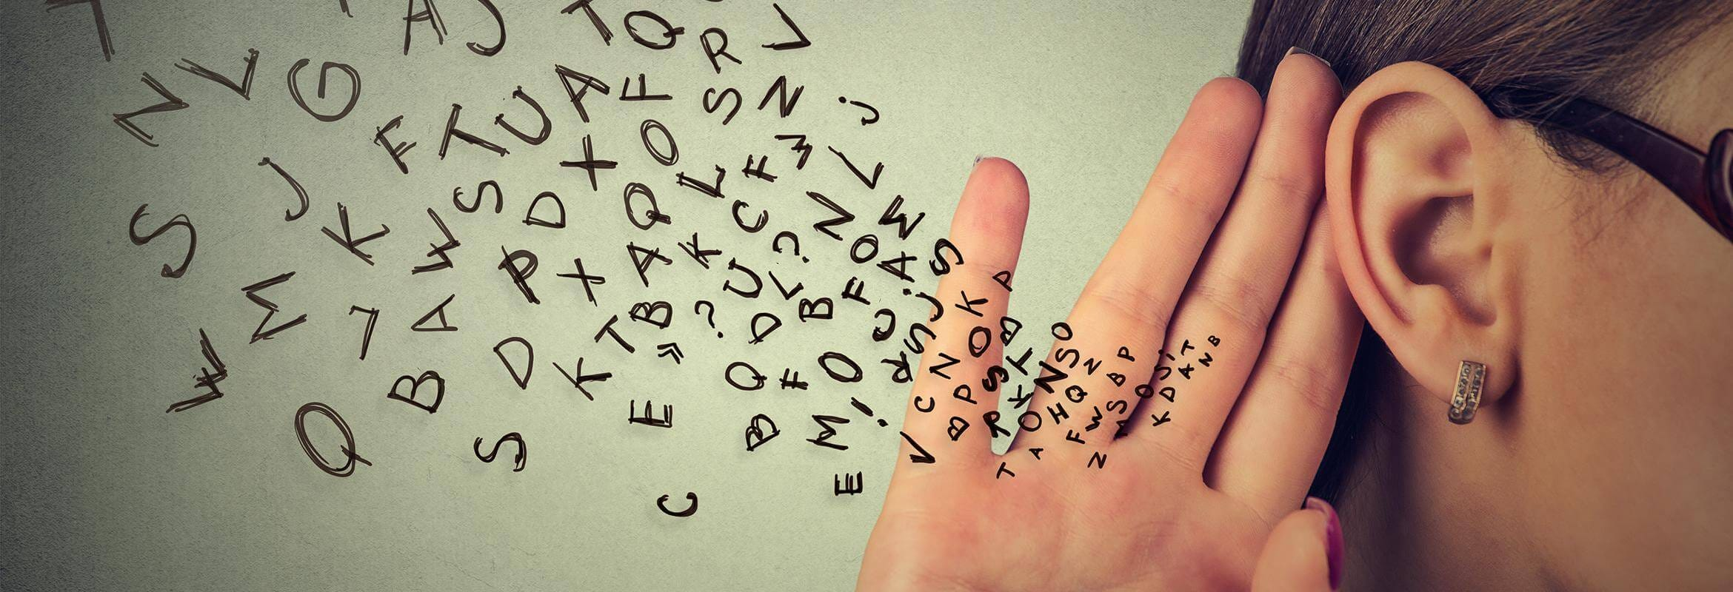
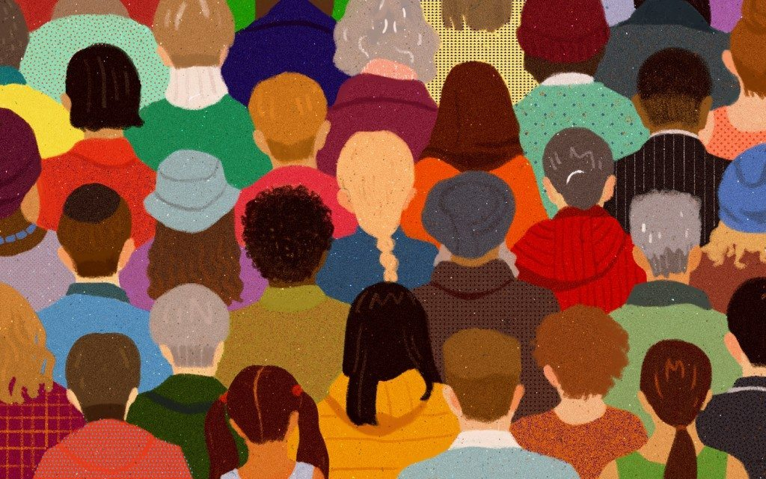

OVERCOMING OF BARRIERS OF COMMUNICATION
Active Listening
Clear and concise language
Cultural awareness and sensitivity
Open feedback channels

Slide 7
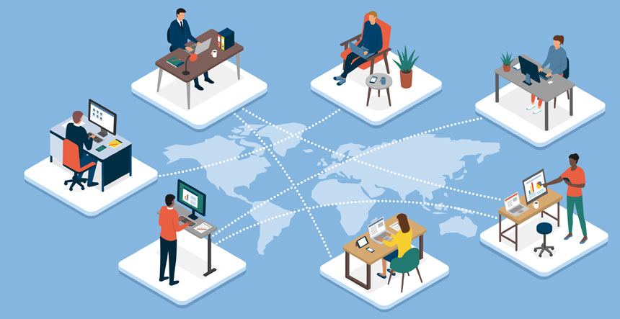
Real World Example
Scenario: Global team facing language and cultural barriers.
Solution: Implementing translation tools and cultural training.
Outcome: Improved communication and collaboration.

Slide 8

CONCLUSION
So we conclude, let’s quickly recap the key points. We began by defining communication barriers as obstacles that interfere with the flow of information. We then discussed the four major types: physical, language, psychological, and cultural barriers, and explored their impact on communication, such as misinterpretation and reduced productivity. Finally, we looked at strategies to overcome these barriers, including active listening, clear language, cultural awareness, and open feedback channels.The key takeaway here is that communication is a twoway street. By being mindful of these barriers and actively working to overcome them, we can ensure that our messages are not just heard but understood. Remember, effective communication isn’t just abou speakingit’s about connecting.

Slide 9


QUESTION & ANSWER

Slide 10
THANK YOU!

